Slide 1
The knapsack problem
Given
  n objects numbered from 1 to n. Object i has a positive weight w_{i} and a positive value v_{i}
  a knapsack that can carry a weight not exceeding W
Problem
  Fill the knapsack in a way that maximize the value of the included objects, while respecting the capacity constraints
  In this version, we assume that the objects can be broken into small pieces

Slide 2
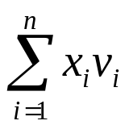
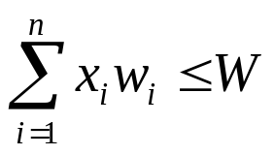
Formal description
Given W; w_{i}, v_{i}
Find an array x_{i}, 1<=i<=n, 0<=x_{i}<=1, to
  Maximize
  And be subject to

Slide 3
A greedy algorithm
Knapsack(w[], v[], W)
{
for (i=1; i<=n; i++)
x[i] =0;
weight = 0;
while (weight < W) {
i = select the best remaining object;
if (weight + w[i] < W)
x[i] = 1;
else
x[i] = (W-weight)/w[i];
}
return x;
}
The key is
which object
to select

Slide 4
Selection methods
Choose the most valuable remaining object
Choose the lightest remaining object
Choose the object with the highest value per weight unit.
n=5, W=100
w | 10 | 20 | 30 | 40 | 50
v | 20 | 30 | 66 | 40 | 60
v/w | 2.0 | 1.5 | 2.2 | 1.0 | 1.2
Method 1 |  |  | 1 | 3 | 2 | 146
Method 2 | 1 | 2 | 3 | 4 |  | 156
Method 3 | 2 | 3 | 1 |  | 4 | 164

Slide 5

Optimality of method 3
If the objects are selected in order of decreasing then the algorithm knapsack finds an optimal solution
  The algorithm generates a solution either including all objects or fill the knapsack full

